Slide 1
TSG Work in progress
TSG Wiki
http://tsgdoc.socsci.ru.nl/index.php/Main_Page
Manufacturing from old to new school
Programming mobile applications

Slide 2
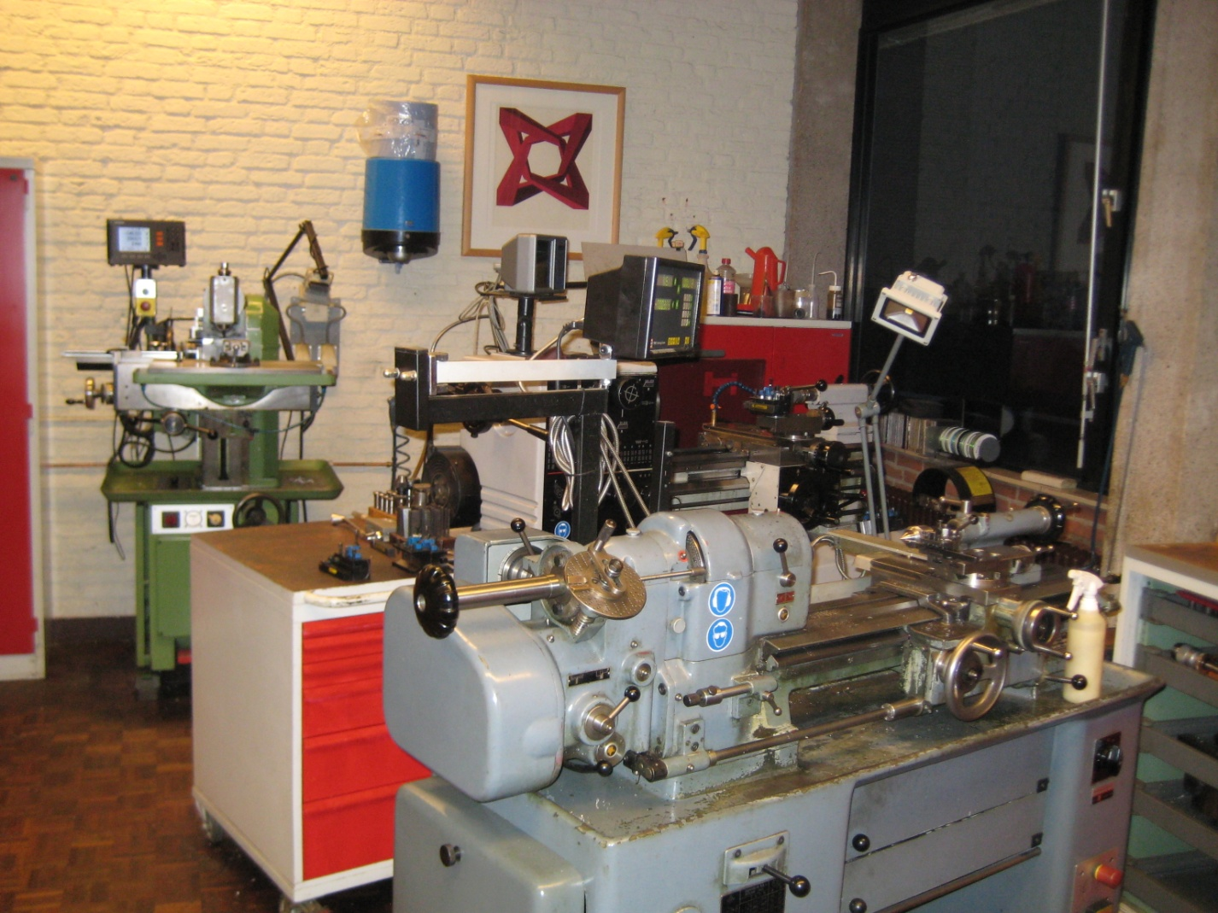
Conventional started 1965

Slide 3
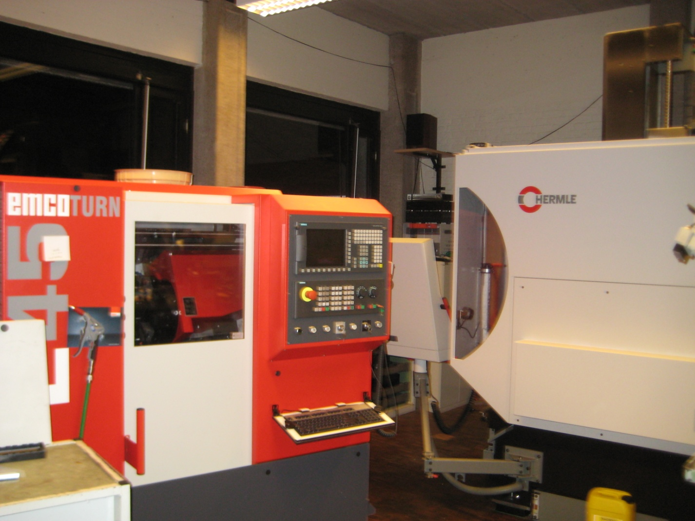
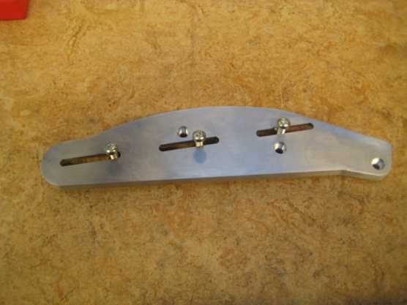
CNC started in 1999
Some products

Slide 4
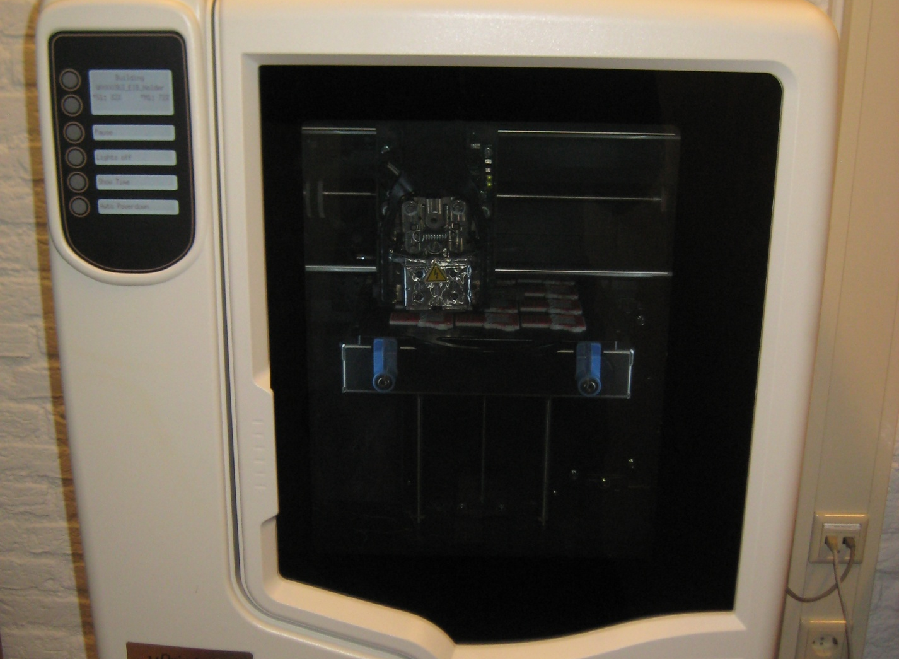
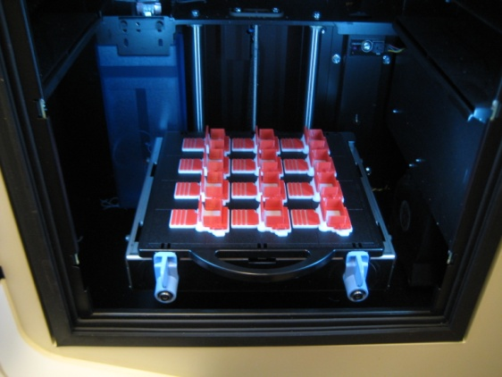
Rapid prototyping 2013

Slide 5
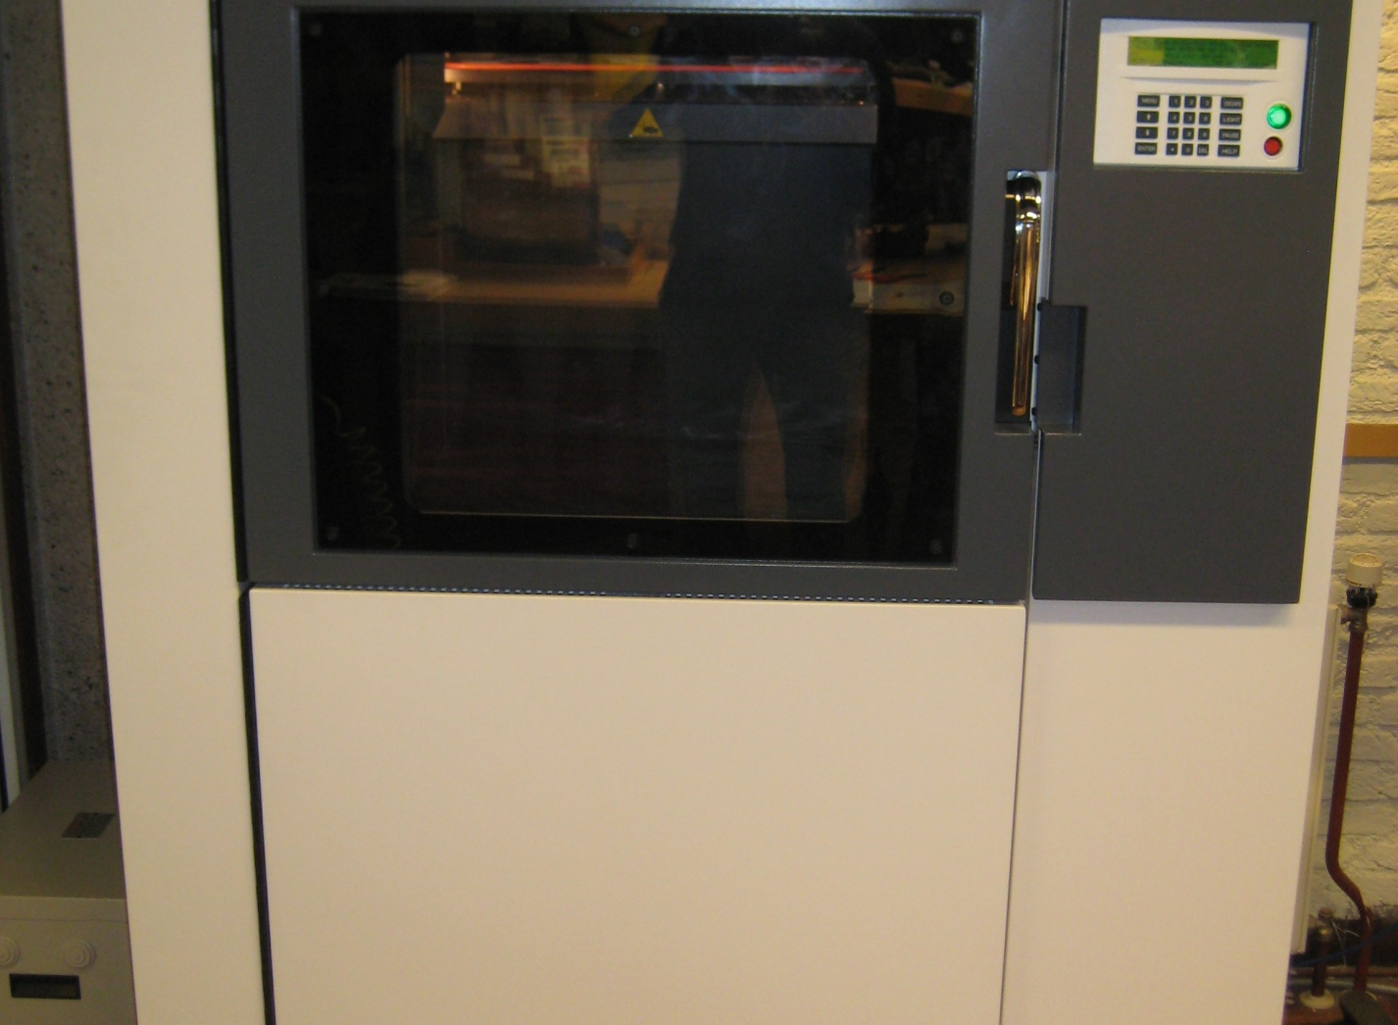
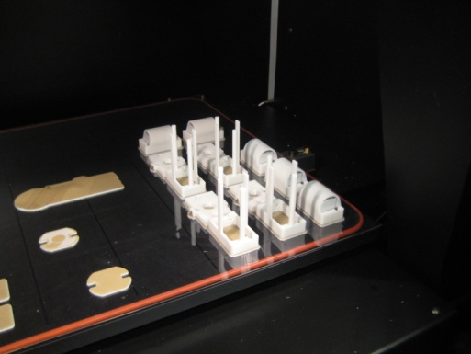
Rapid prototyping 2014

Slide 6
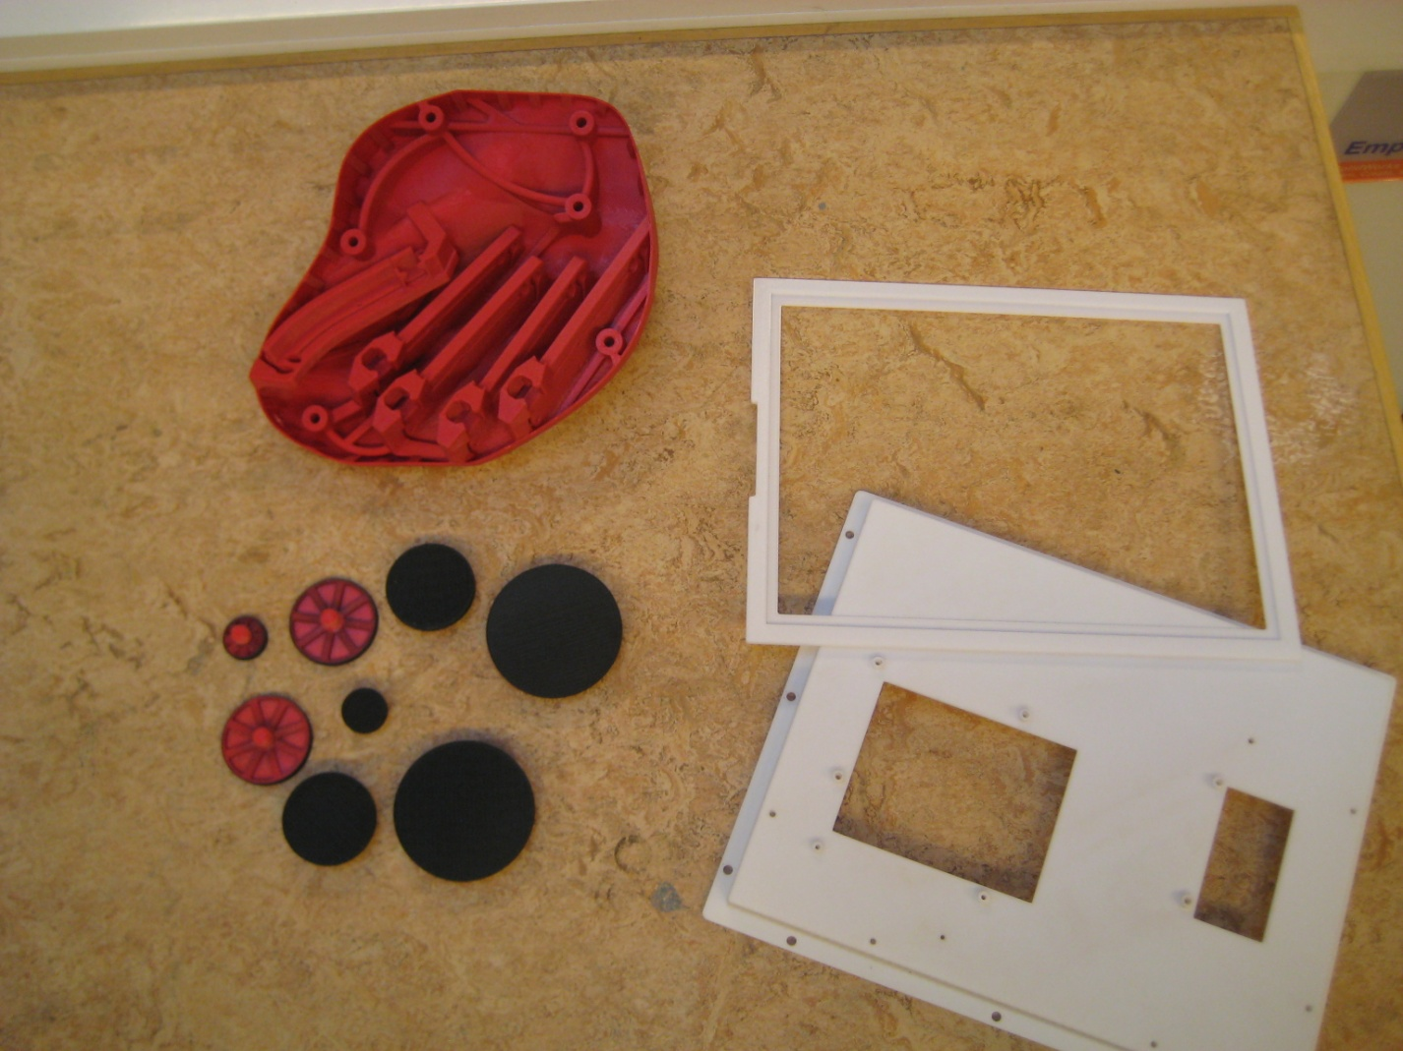
Some examples

Slide 7
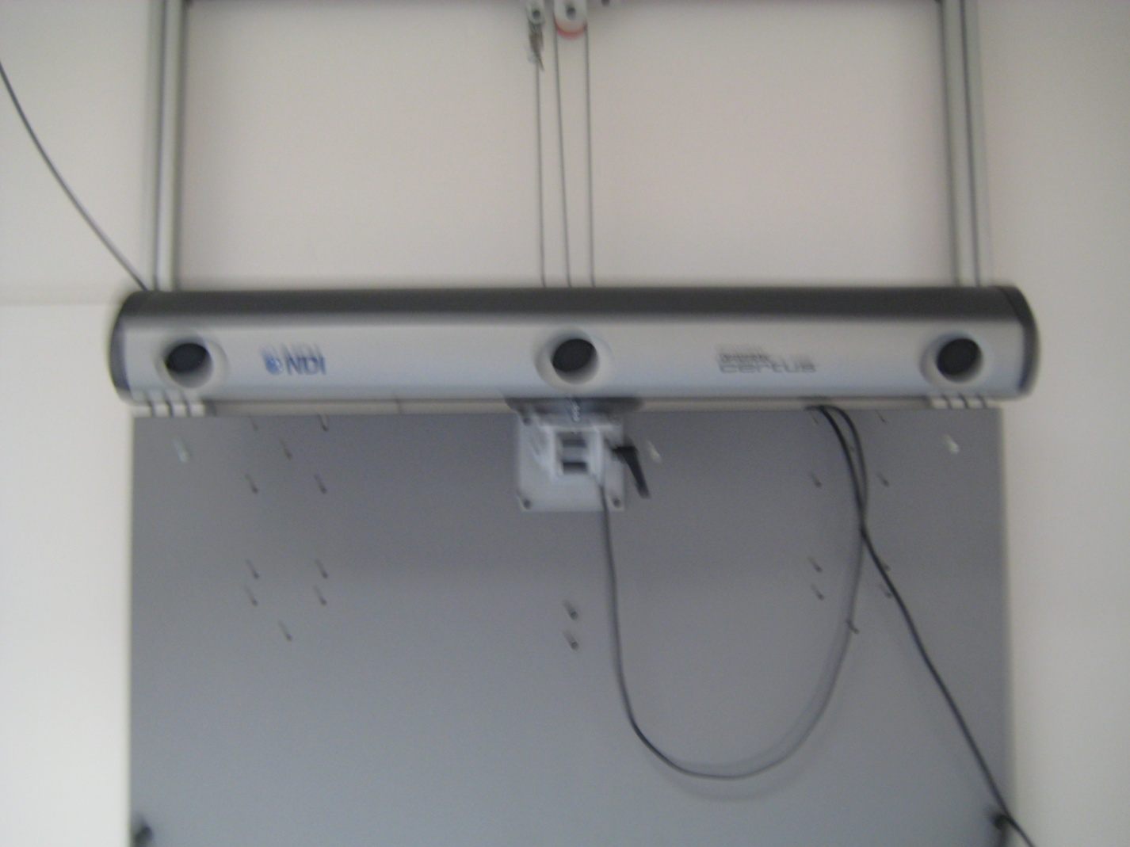
New equipment Certus Optotrack

Slide 8
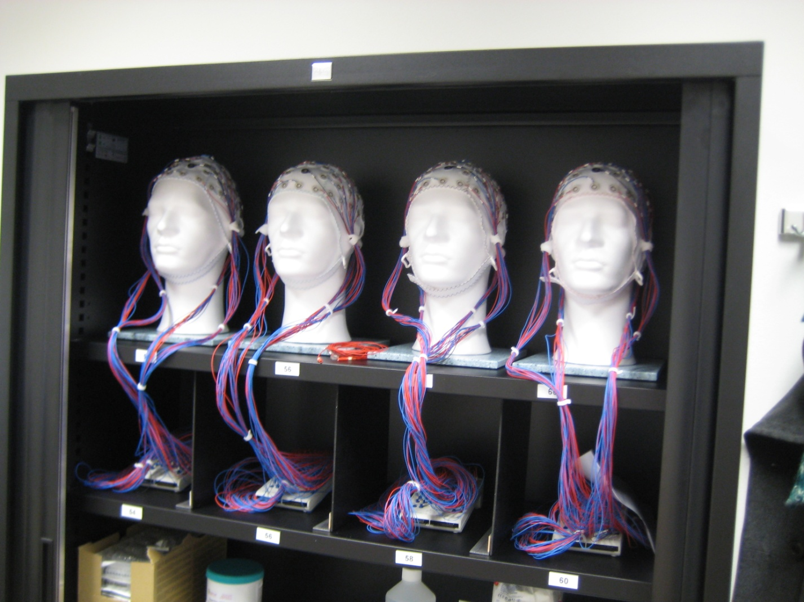
TMS, Nirs and EEG

Slide 9
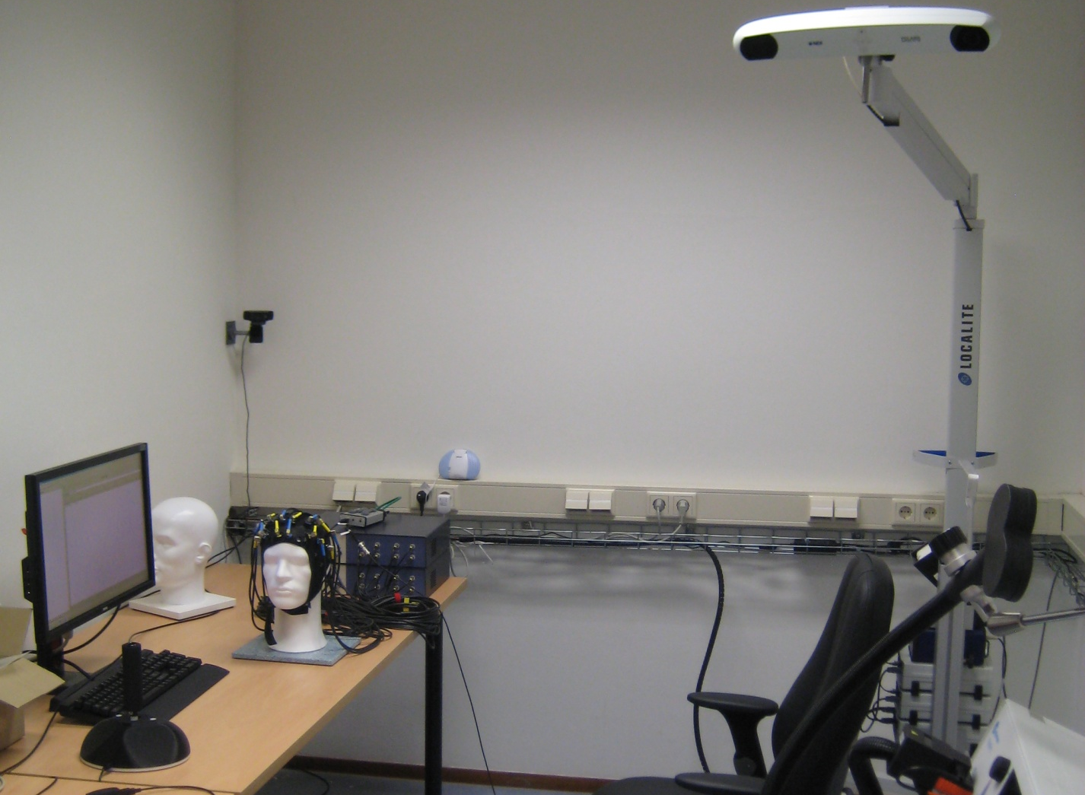
TMS, Nirs and EEG

Slide 10
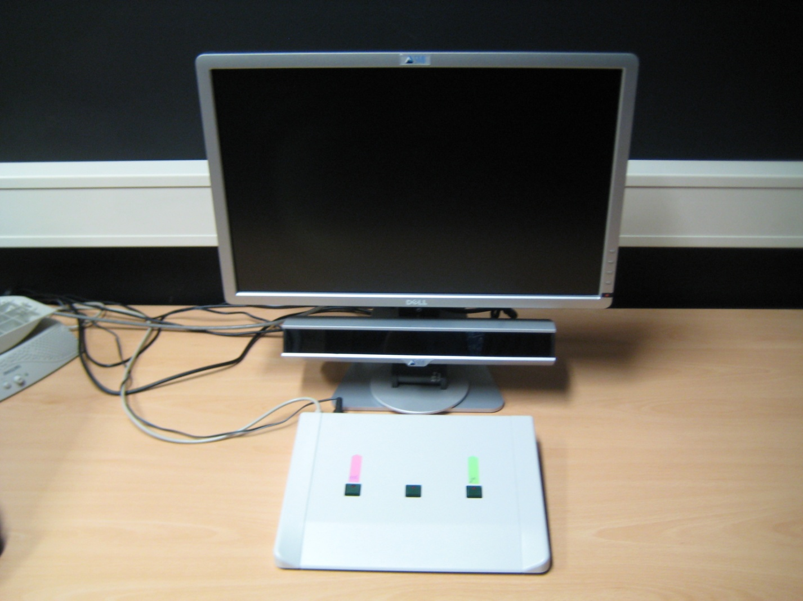
SMI eyemovement

Slide 11
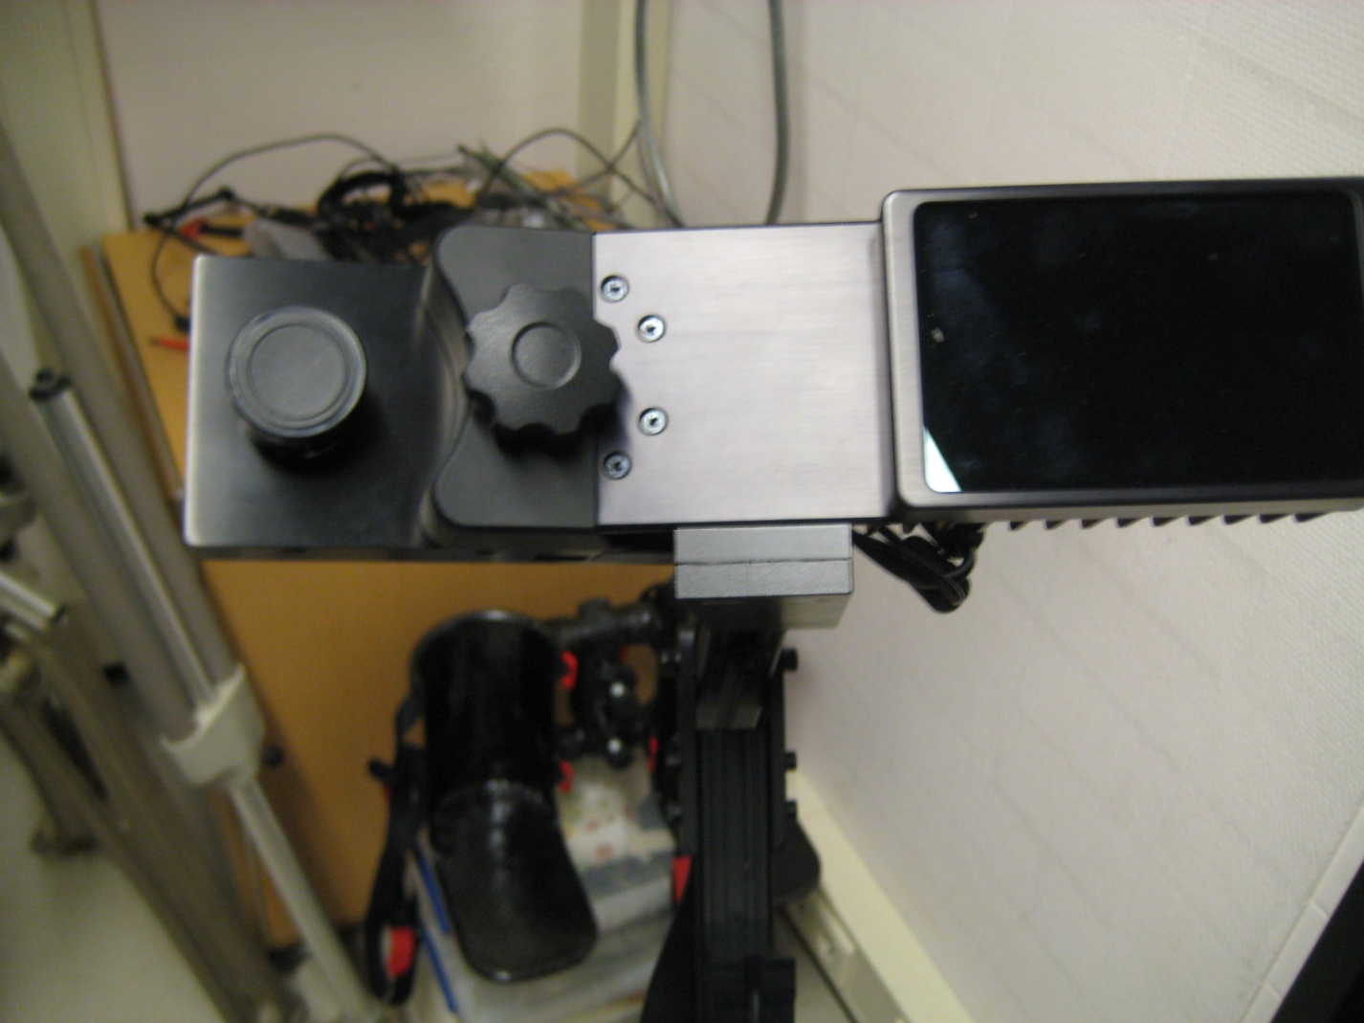
Porteable Eyelink 1000+

Slide 13
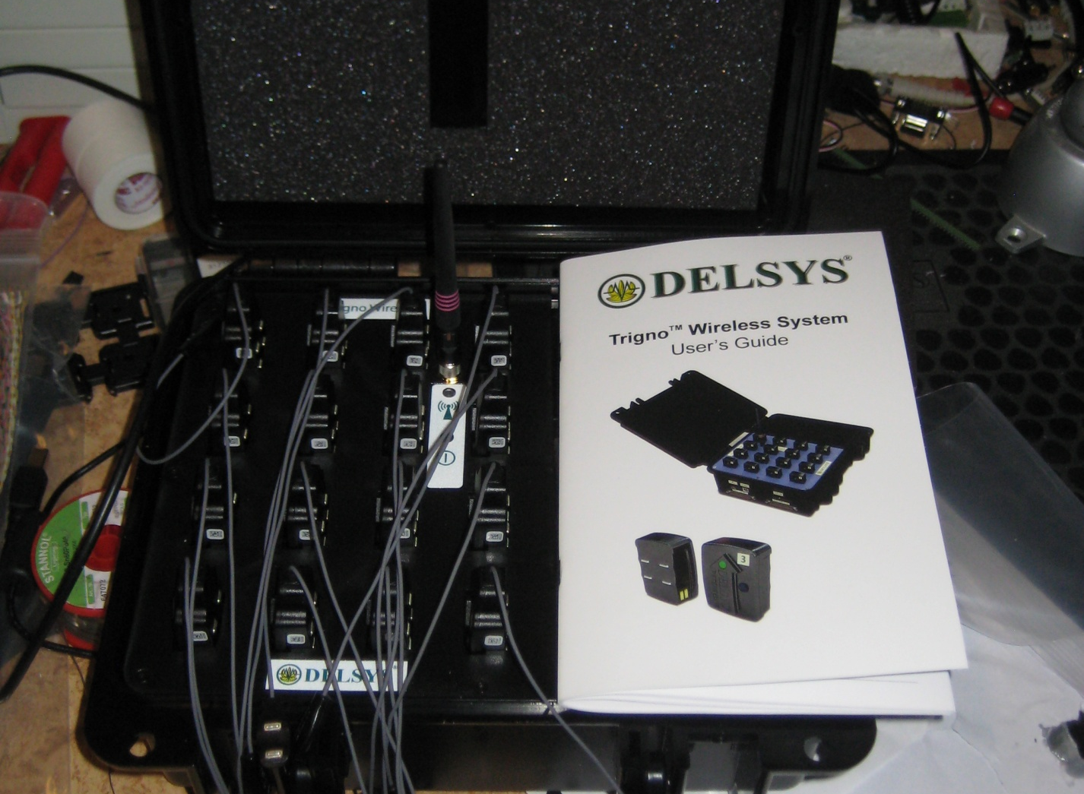
Wireless EMG and accellerometers

